Slide 1
Place Value
Year 10 Mathematics
Mrs Parlevliet

Slide 2
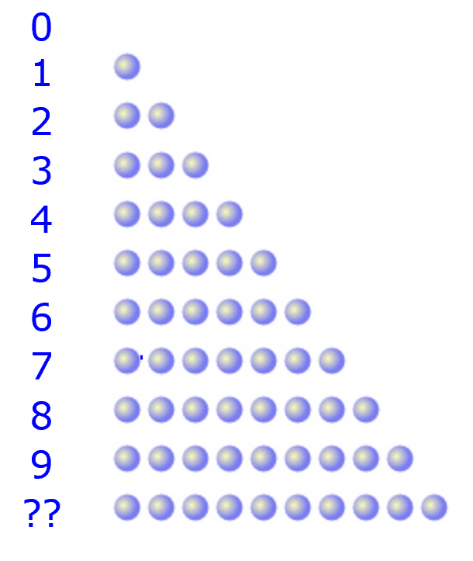
24
7
30
Place Value
Date
EQ – What is place value?
What are digits?
The digits we use today are:
0, 1, 2, 3, 4, 5, 6, 7, 8, 9
We can use them to count up to 9.
What happens after 9?
Notes:
Ask student to write questions for the notes.
Model Chunking of notes.

Slide 3
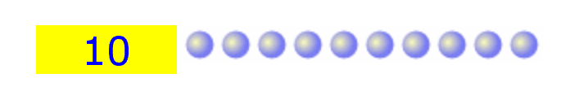
24
7
30
Place Value
Date
EQ – What is place value?
What happens after 9?
Ten or more…
When we have more than 9 we need to start another column. This is the tens columns. It tells us how many lots of tens are in a number.
We write:
Notes:
Ask student to write questions for the notes.
Model Chunking of notes.

Slide 4
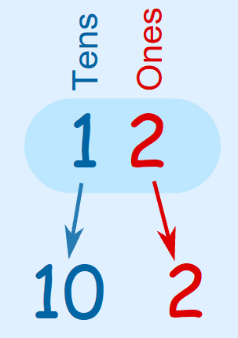
24
7
30
Place Value
Date
EQ – What is place value?
How do we write numbers larger than 9?
Let’s look at how we write the number 12.
Notes:
Ask student to write questions for the notes.
Model Chunking of notes.

Slide 5
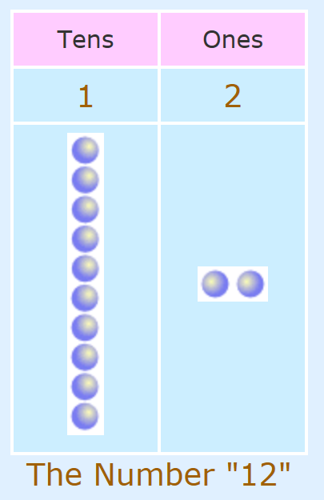
24
7
30
Place Value
Date
EQ – What is place value?
How do we write numbers larger than 9?
There is one group of 10.
There is one group of 2 units.
Notes:
Ask student to write questions for the notes.
Model Chunking of notes.

Slide 6
24
7
30
Place Value
Date
EQ – What is place value?
How do we write numbers larger than 9?
There is one group of 10.
There is one group of 2 units.
Notes:
Ask student to write questions for the notes.
Model Chunking of notes.

Slide 7
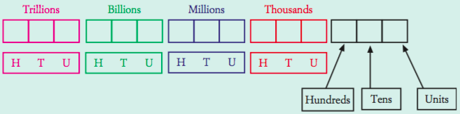
24
7
30
Place Value
Date
EQ – What is place value?
The following 10 digits: 0,1,2,3,4,5,6,7,8,9. These digits can be combined to create numbers both large and small, using the place value system.
Place value system – The place in which you write a digit affects its value. The larger place values are on the left and each place is 10 times as big as the one before it.
Each group of three numbers is a ‘house’. Inside each house the numbers go from one to nine hundred and ninety-nine

Slide 8
Math Antics – Place Value Video
https://www.youtube.com/watch?v=T5Qf0qSSJFI

Slide 9
Place Value Task
Use the place value card sets to show what the place values of digits in these numbers are.
28
85
607
123
2453
9841
7095
37398

